Slide 1
Introduction to .Net

Slide 2
Before .Net (Microsoft)
FRONT END
(VC++/ VB 6/ ASP)
MIDDLE TIER
(COM)
DATABASE (ANY)

Slide 3
Problems (Pre .Net)
VC++ -> Had OO and threading but Complex
VB6 -> Not OO and no threading but Simple
ASP -> Script based, Interpreted, Late Bound, Difficult to maintain and debug, not OO
COM -> DLL HELL! (Mainly versioning and deployment)

Slide 4
.Net Features
OO Code
Multiple Languages
Multiple platforms*
Multiple project types( eg web based, desktop based, etc)
Better Security
Improved Performance

Slide 5
.Net framework
Hardware
Operating System
.Net Framework

Slide 6
SOURCE CODE
(Any .Net Language)
Eg, C#,Vb.Net
Web Application, Windows Forms, Console Apps, Web Services, WCF, WPF, Workflow, ASP.Net MVC, .Net Core, Xamarin, Windows Services, Web API
.Net Base Class Library
System.Dll, System.Data.Dll, System.Xml.Dll etc
COMPILE
ASSEMBLY
(EXE/DLL)
BYTE CODE
MSIL/CIL/IL
Common Language Runtime(CLR)
JIT Compilation
Memory Management
Garbage Collection
App Domain Management*
Common Language Specification
Common Type System
Thread Management
Security Management
Debugging
Exception Handling

Slide 7
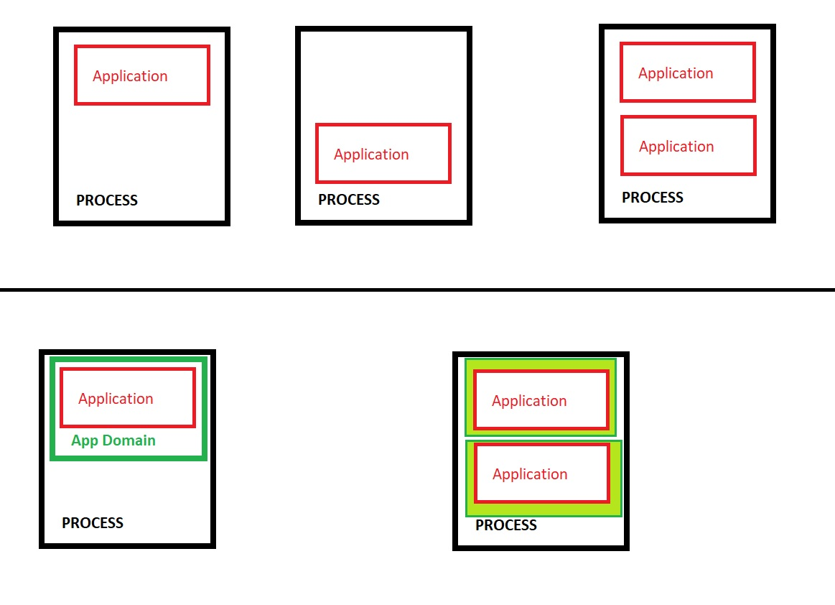
App Domains

Slide 8
So what is the .Net Framework???
.Net Base Classes
+
CLR
+
Utilities

Slide 9
And what would you need to run your code on other platforms???

Slide 10
Difference between .Net Framework, .Net Core, Mono and Xamarin
.Net Framework used for Windows platform mainly
Mono used for Linux
Xamarin used for Mobile platforms(Android, iOS and Windows)
.Net Core used for all platforms

Slide 11
What is .NET Standard?
There are various implementations of .NET. Each implementation allows .NET code to execute in different places—Linux, macOS, Windows, iOS, Android, and many more. .NET Standard is a formal specification of the APIs that are common across all these .NET implementations.
.NET Standard allows libraries to build against the agreed on set of common APIs, ensuring they can be used in any .NET application—mobile, desktop, IoT, web, or anywhere you write .NET code.
.Net Standard 2.0 specification targets all the latest versions

Slide 12
.Net Core Key Features
Open-source
Cross-platform
Lightweight
Extensible

Slide 13
Roslyn
Roslyn is a set of open-source compilers and code analysis APIs for C# and Visual Basic (VB.NET) languages from Microsoft.
.NET Compiler Platform is the technical name popularly called Roslyn

Slide 14
.Net Framework/Core History
Net Framework 1 – Feb 2002
.Net Framework 2 – Oct 2005
.Net Framework 3 – Nov 2006
.Net Framework 3.5 – Nov 2007
.Net Framework 4 – Apr 2010
.Net Framework 4.8 – Aug 2022
.Net Core 1 – June 2016
.Net Core 2 – Aug 2017
.Net Core 3 – Sep 2019
.Net 5 – Nov 2020
.Net 6 – Nov 2021
.Net 7 – Nov 2022
.Net 8 – Nov 2023 (proposed)

Slide 15
.Net Core
Upto Version 2.2 only supports ASP.NET MVC and Web Apis
Version 3+ supports Winforms and WPF also
Course covers version 6/7 (.Net 7)

Slide 16
What will we be working with?
Visual Studio 2022 Community Edition- .Net 7
C#
Console Apps/Class Library
Asp.Net Core MVC
Web Api

Slide 17
Managed vs Unmanaged code
Managed code is run by CLR (All .net code)
Unmanaged code is not run by CLR
Egs Windows DLLs (PInvoke) and COM Apps (using COM Interop)

Slide 18
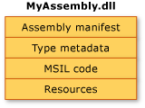
Assembly Structure

Slide 19
Assembly Manifest
Contains…
Assembly Name
Version Number
Culture
Strong Name
List of files contained
References
Type Reference information

Slide 20
Can’t wait to start coding ☺

